Slide 1





BlackJack2018 NoName
Markus Heino
Jussi Jokio
Juhana Poikela

Slide 2
Work Progress
Already completed
Design
API (some small, things missing)
Frontend(not integrated)
Backend(not integrated)
TODO
Integration
Deployment
Chat

Slide 3
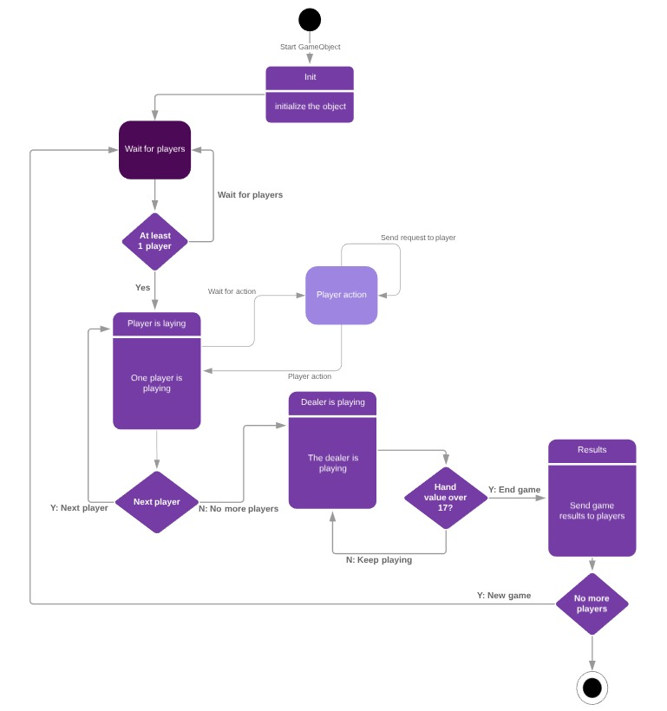
State Diagram

Slide 4
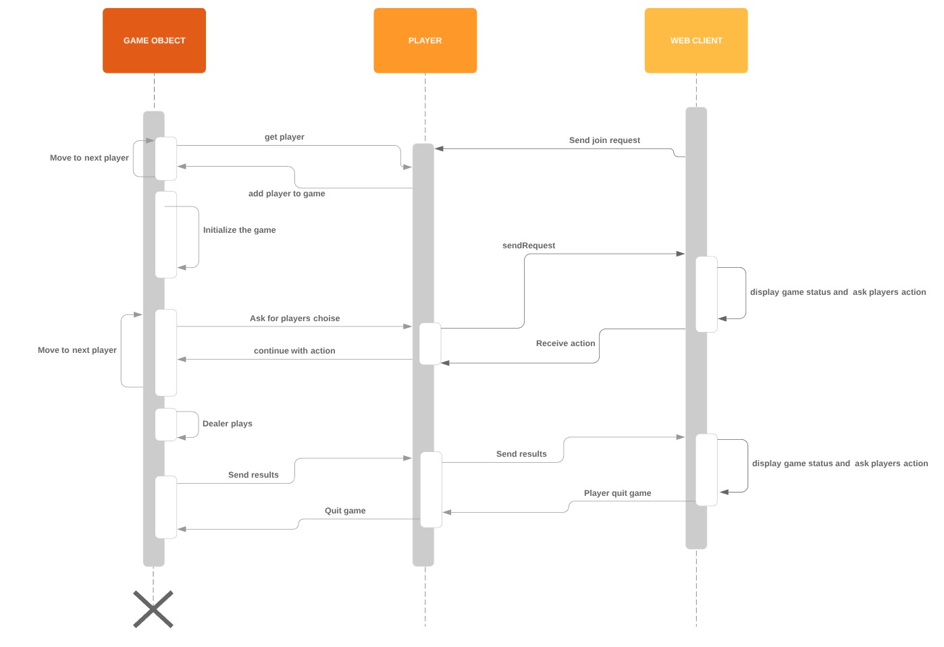
Sequence Diagram

Slide 5
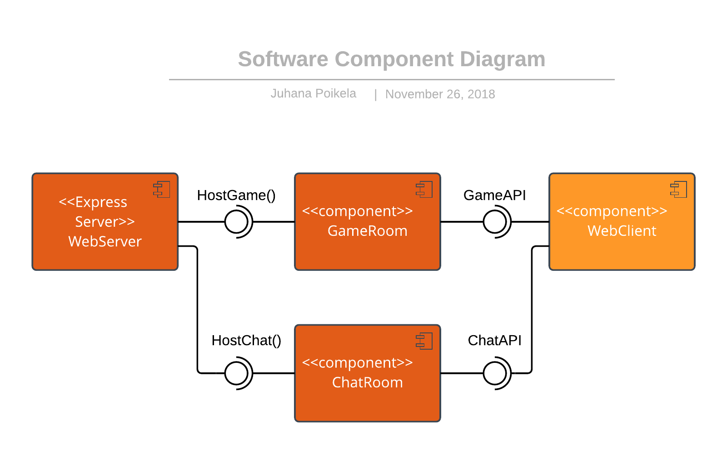
Software Component Diagram

Slide 6
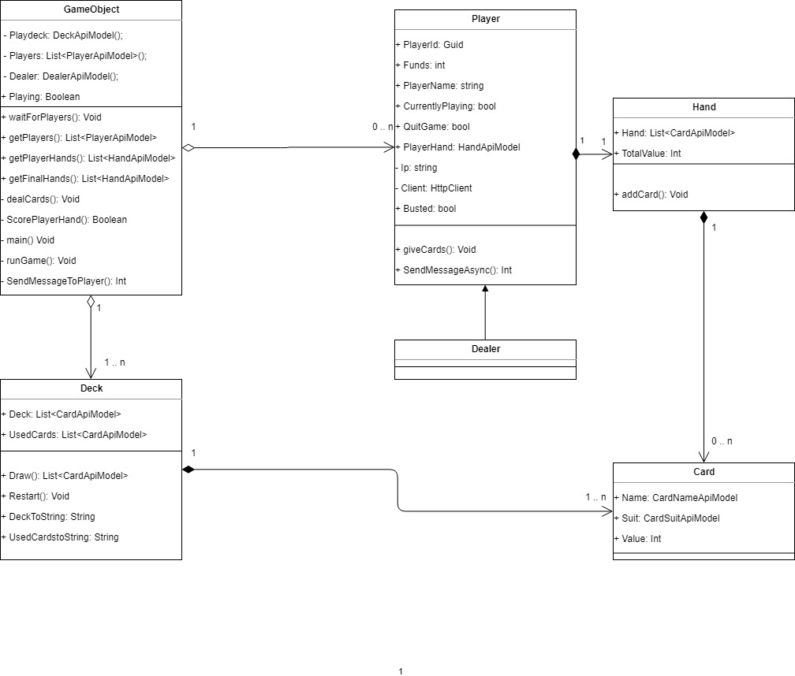
Class Diagram

Slide 7
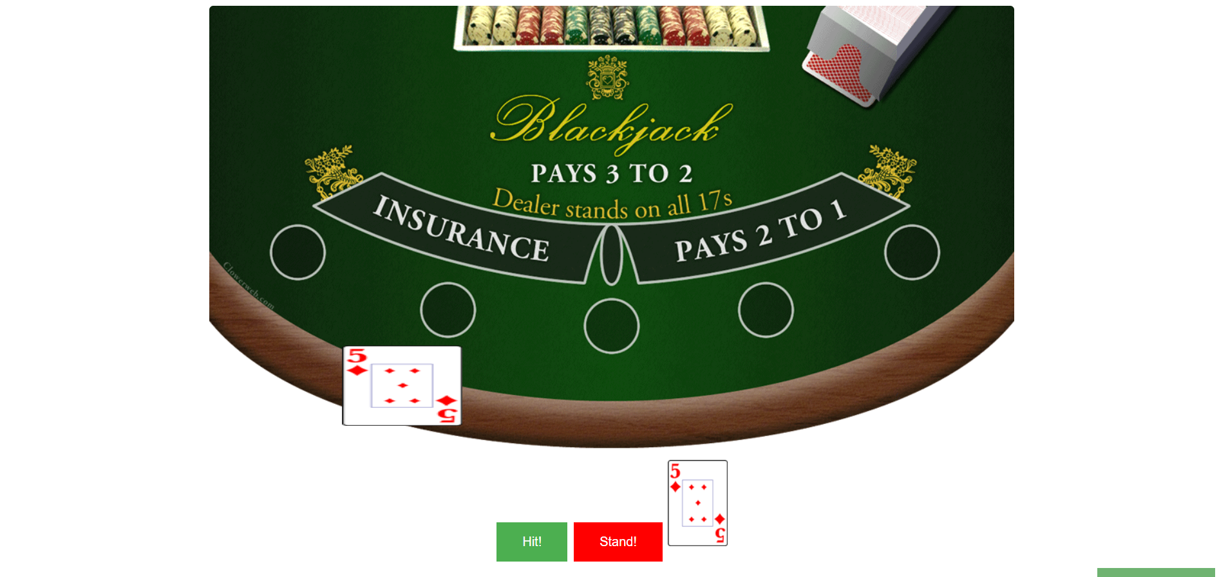
Interface Screenshot (chat closed)

Slide 8
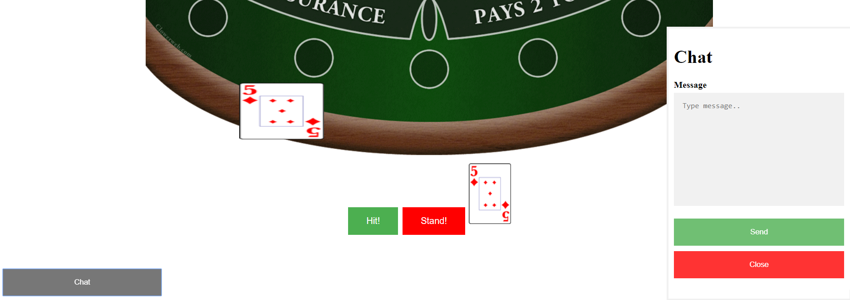
Interface Screenshot (chat open)

Slide 9
Tools
Documentation
Lucidchart, IoDraw
Word, Power point
Frontend
Visual code
JS, Html5.(angularjs)
Backend & API
C#,.Netframework
Azure
Visual studio
Express
Socket.io

Slide 10
Thank You!
Markus Heino
Jussi Jokio
Juhana Poikela

